Slide 1


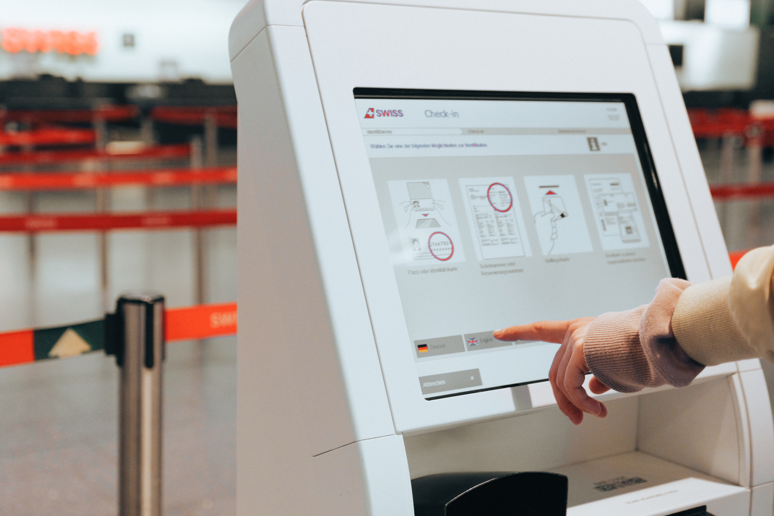
FIFO:
PGPC QUEUE MANAGEMENT SYSTEM
PRESENTATION BY GROUP 4 | BSCS 2D

Slide 2
INTRODUCTION
Many organizations face significant challenges in managing queues, often resulting in prolonged waiting times and disorganized lines. These issues contribute to frustration and inefficiency among both clients and staff members.

Slide 3
INTRODUCTION
To address these challenges, the FIFO: PGPC Queue Management System was developed. The system operates on the First-In, First-Out principle, ensuring that clients are served in the order of their arrival while providing real-time updates on queue status.

Slide 4

OBJECTIVES
To organize queues efficiently using FIFO logic, guaranteeing fairness.
To reduce crowding and alleviate stress for both clients and staff.
To provide a user-friendly digital system that functions offline, ensuring reliability.

Slide 5

SYSTEM FEATURES
Digital ticketing system for assigning queue numbers
First-In, First-Out (FIFO) logic to ensure fair service order
Real-time display of the current number being served
Admin controls to call, skip, or reset queue numbers

Slide 6
CONCLUSION
The FIFO Queue Management System offers a straightforward and effective solution to improve fairness and order in queue management. It enhances the overall experience for clients and staff, with potential for future enhancements and integrations.

Slide 7
THANK
YOU
www.reallygreatsite.com

